Slide 1
NimbusHR Customer Churn Analysis
Executive Business Case Study
End-to-End Data Analytics Project
Prepared by Joshua C.
Tools Used
Excel | SQL | Power BI

Slide 2
Business Problem
NimbusHR is a B2B SaaS company experiencing slower growth in Monthly Recurring Revenue (MRR).
Executive leadership requested an analysis to answer five business questions:
• Why has revenue growth slowed?
• Which customers are most likely to churn?
• Which subscription plans generate the highest revenue?
• Which customer segments represent the highest business risk?
• What actions should the business prioritize to improve retention?

Slide 3
Project Methodology
Business Understanding Data Preparation
(ASK) (PREPARE)
Data Cleaning Business Analysis
(PROCESS) (ANALYZE)
Executive Dashboard Business Recommendations
(SHARE) (ACT)
Framework based on the Google Data Analytics Process.

Slide 4
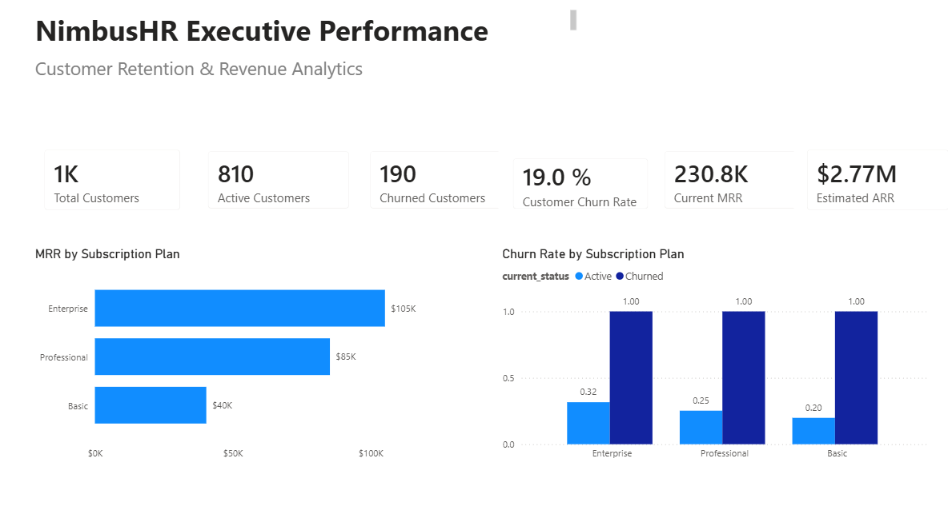
Executive Dashboard
Executive Overview
Executive Insights
• NimbusHR currently manages a portfolio of 1,000 customers.
• Customer churn has reached 19%, directly impacting recurring revenue growth.
• Enterprise subscriptions generate the largest share of Monthly Recurring Revenue.
• Improving customer retention is expected to deliver a greater long-term impact than increasing customer acquisition alone.

Slide 5
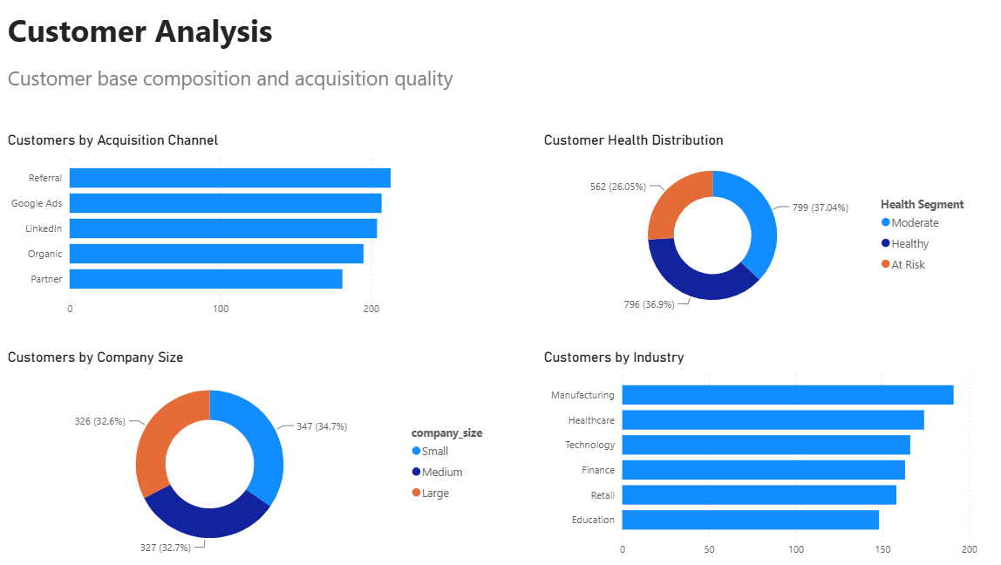
Customer Analysis
Understanding the Customer Base
Executive Insights
• Customer acquisition is well diversified across multiple marketing channels.
• Manufacturing and Healthcare represent the largest customer segments.
• Company size is evenly distributed, reducing dependency on a single customer profile.
• Most customers maintain a healthy engagement level, providing a strong foundation for future growth.

Slide 6
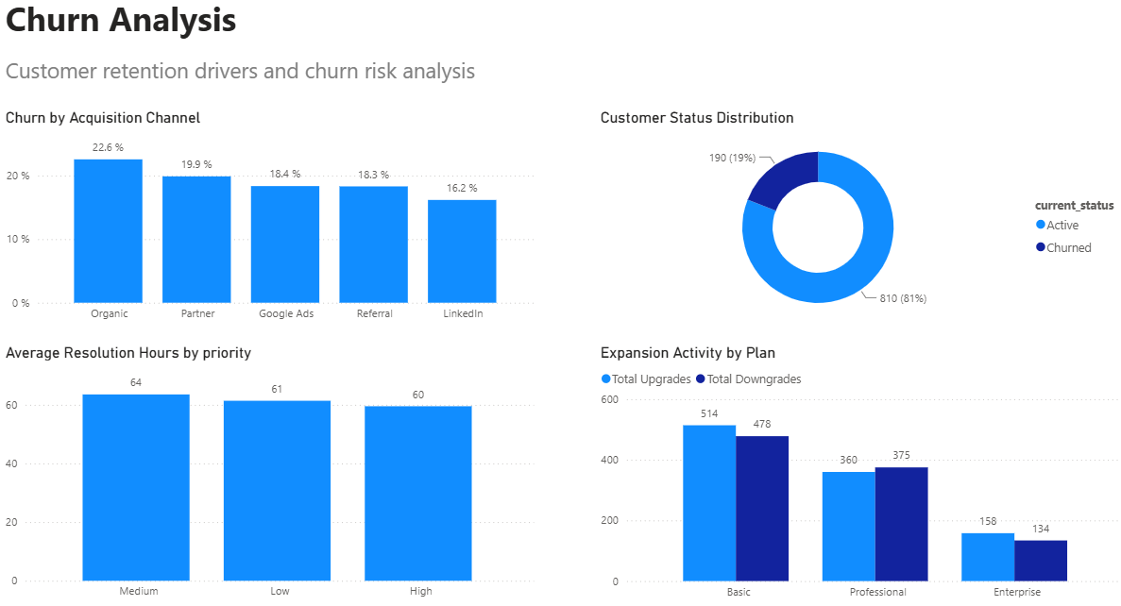
Churn Analysis
Understanding the Drivers of Customer Churn
Executive Insights
• Customer churn is not evenly distributed across the customer base.
• Customer status distribution confirms that retention should remain a strategic business priority.
• Expansion activity varies across subscription plans, indicating opportunities for targeted growth initiatives.
• Monitoring customer behavior through leading indicators can help reduce preventable churn and protect recurring revenue.

Slide 7
Business Recommendations
Priority | Recommendation | Expected Business Impact
High | Prioritize retention initiatives for Enterprise customers. | Protect the largest source of recurring revenue.
High | Implement a Customer Health Score monitoring process. | Identify at-risk customers before churn occurs.
Medium | Improve onboarding and product adoption programs. | Increase customer engagement and long-term retention.
Medium | Evaluate acquisition channels based on customer quality, not only acquisition volume. | Improve Customer Lifetime Value (CLV).
Low | Continue monitoring support performance KPIs. | Ensure customer service remains a competitive advantage.
Recommendations prioritized according to expected business impact.

Slide 8
Executive Summary
The analysis identified customer retention as the primary opportunity to improve recurring revenue growth.
Enterprise customers generate the highest Monthly Recurring Revenue and therefore represent the highest financial priority.
A 19% churn rate suggests that proactive retention strategies could significantly increase Annual Recurring Revenue without increasing customer acquisition costs.
The recommended next step is to implement customer health monitoring and targeted retention initiatives focused on high-value accounts.
Project Outcome
✔ Business Problem Solved
✔ Actionable Recommendations Delivered
✔ Executive Dashboard Developed

Slide 9
Thank You
Questions?
Prepared by
Joshua C.
Data Analytics Portfolio Project

